Slide 1
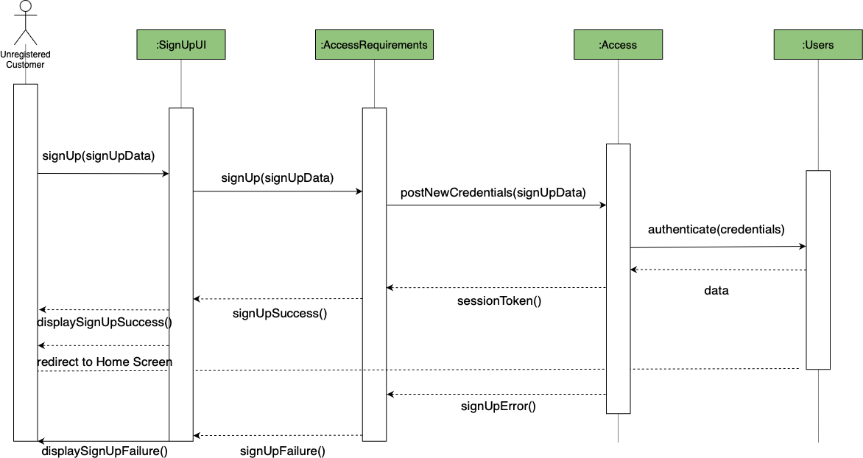
Carriage Sequence Diagram - Team 1
Use Case - 03.04. Sign Up

Slide 2
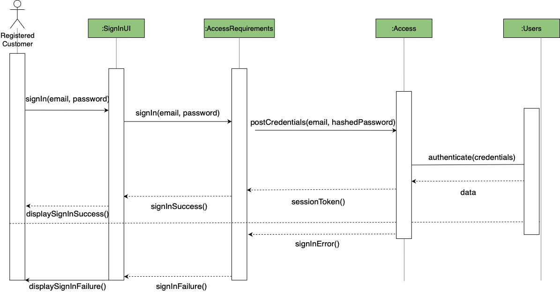
Carriage Sequence Diagram - Team 1
Use Case - 03.05. Sign In

Slide 3
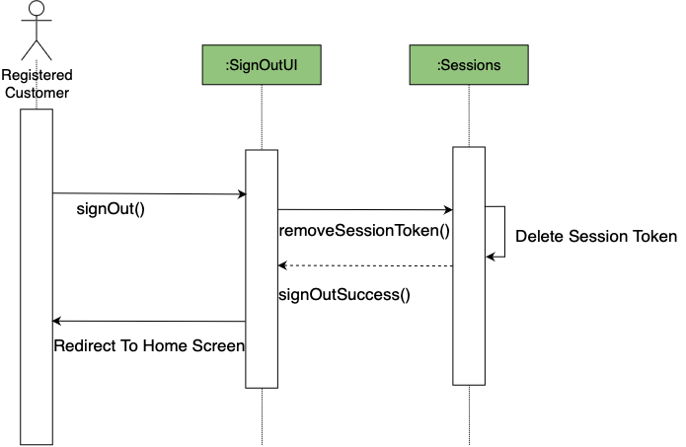
Carriage Sequence Diagram - Team 1
Use Case - 03.06. Sign Out

Slide 4
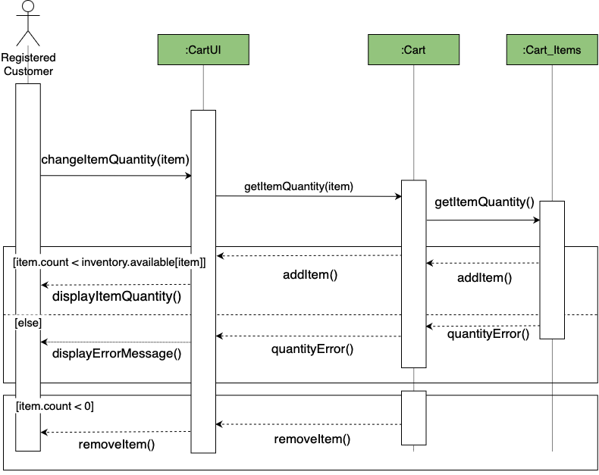
Carriage Sequence Diagram - Team 1
Use Case - 05.03. Manage Orders (make edits)

Slide 5
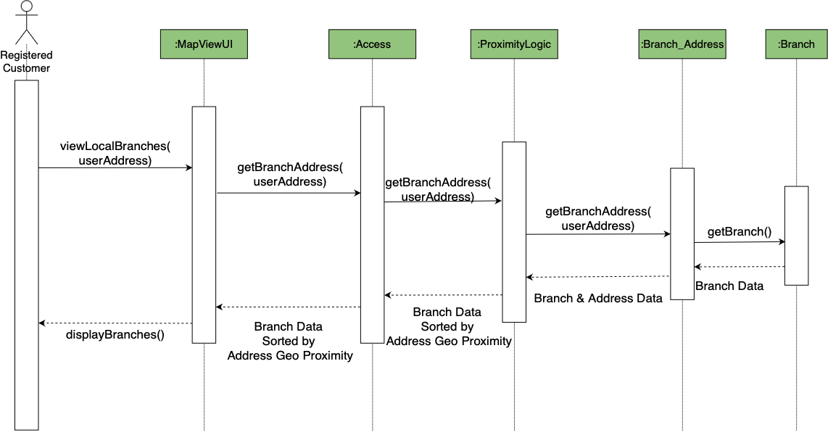
Carriage Sequence Diagram - Team 1
Use Case - 06.02. View Local /Vendors In Vicinity

